Slide 1

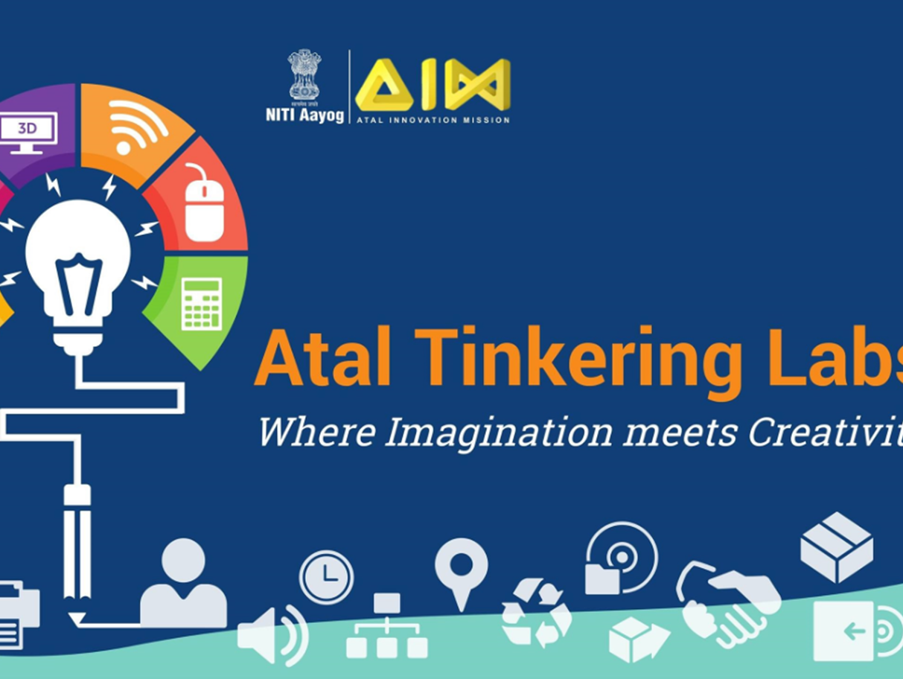
ROBOTICS

Slide 2
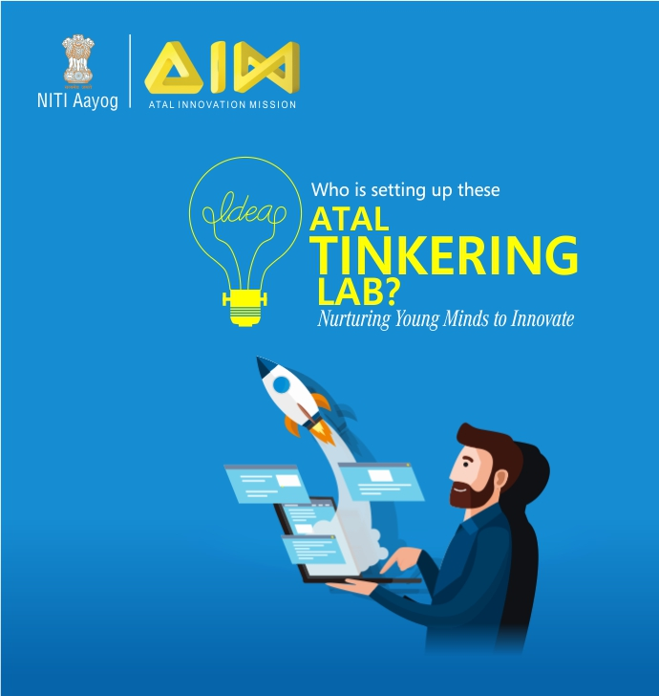

What is ATL?

Slide 3

Mr. PRINCE KALRA
Er. Prince Kalra is working with Chandigarh Institute of drones as a robotic engineer. He has completed B.tech in Electronics and communication engineering from Chandigarh Group of Colleges Jhanjeri Punjab.
He has good experience in Artificial Intelligence, Coding in C, C++, Python, Machine learning. Automation, IOT, Robotics, Web Development, 3D modeling, 3D printing and UAV(Unmanned Aerial Vehicle). UGV (unmanned Ground Vehicle).
He ensures that the machines operate safely, dependably, and with precision; identifies and implements modifications. He trained more than 5000 students and Successfully Completed more than 2000 projects.

Slide 4
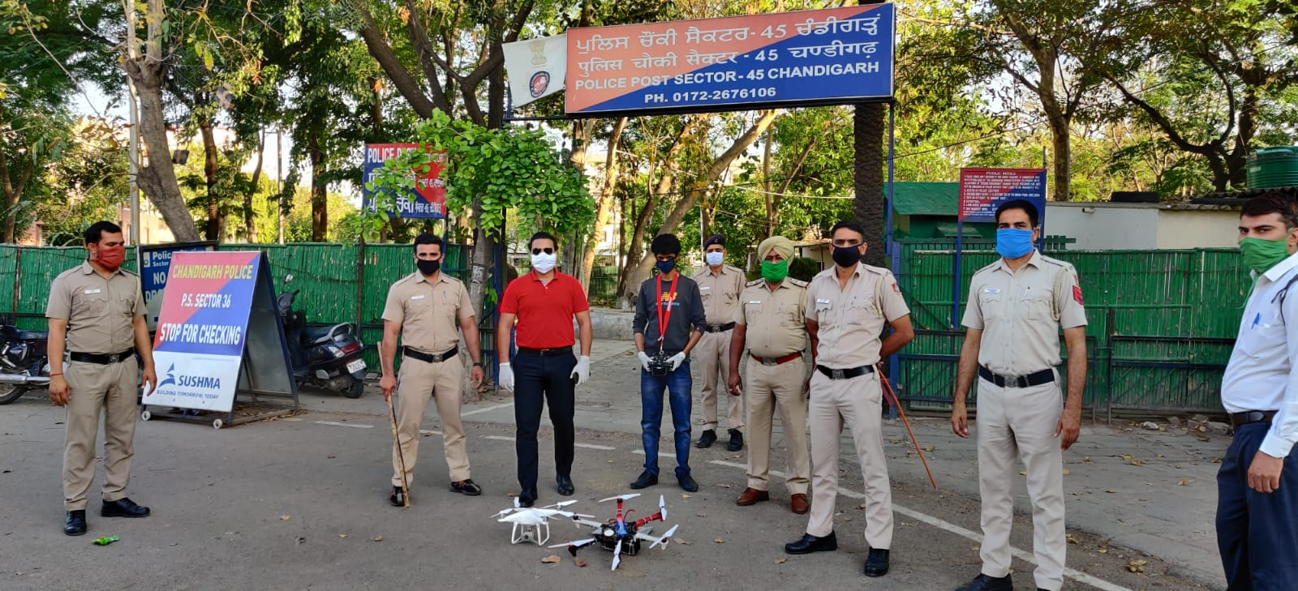
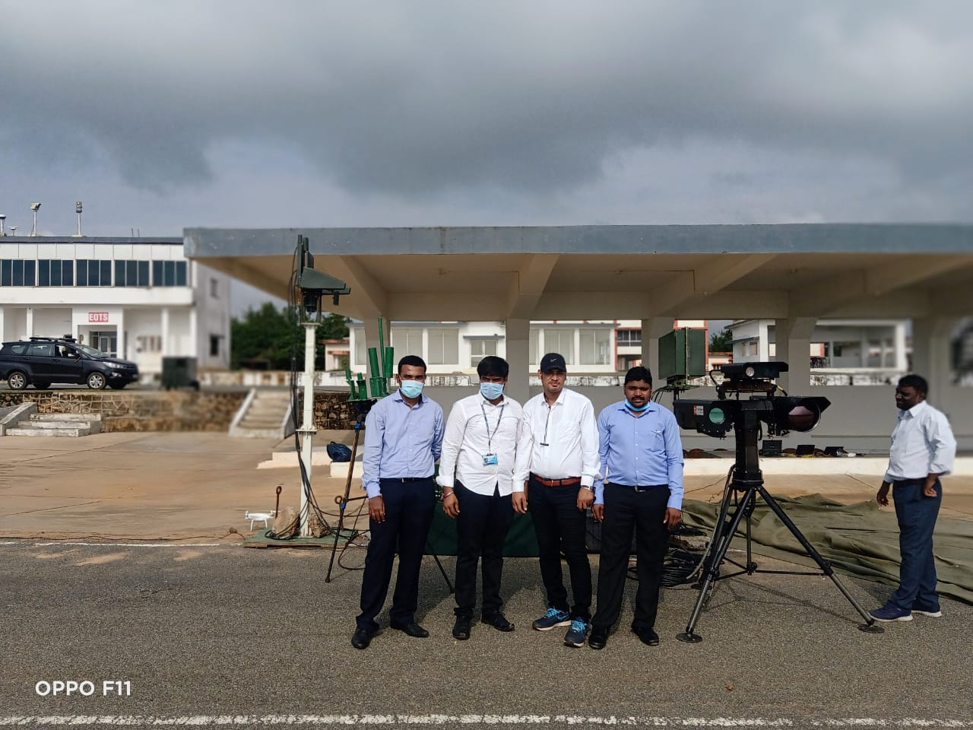
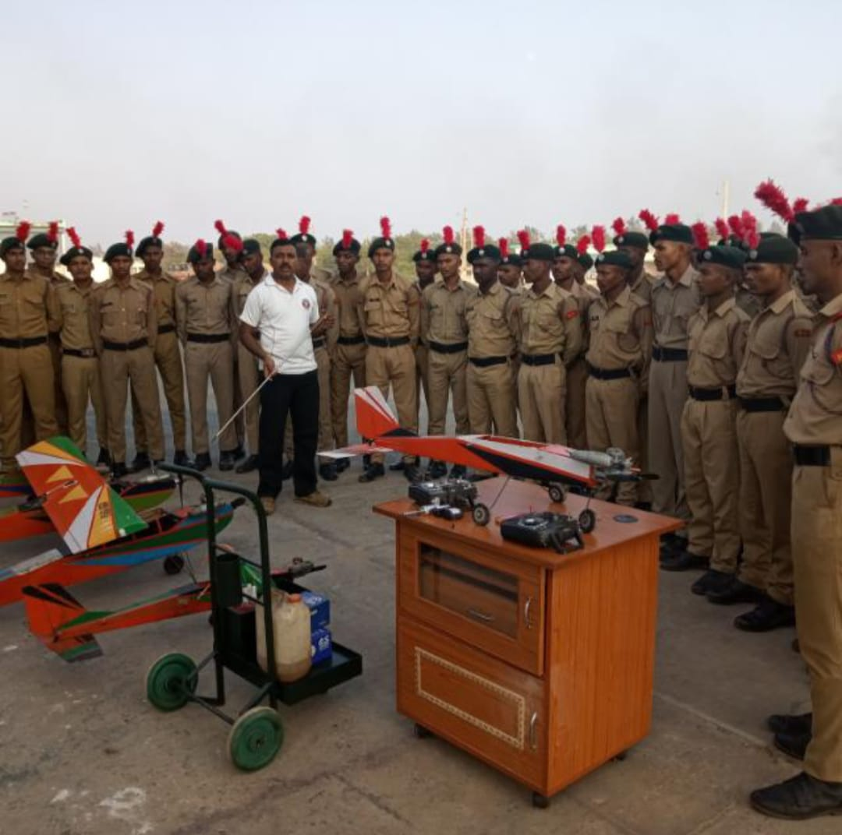
About Us: -
Founded in 2019, by a team of professionals, Group of Engineers provides cutting edge solutions for different verticals thru high-end technical ,backend and practical support in the field of Education, Research & development and manufacturing . Chandigarh institute of drones is a Pioneer in the field of Training Services in Schools, UAS training , setting up ROBOTIC labs in India. Starting in the initial years with activities like Teacher's training for robotics , 3d modeling, Drones, AI , Programming & Web designing.
Our Services : -
ATAL TINKERING LAB
STEM TINKERING LAB
DRONE LAB
ROBOTICS TRAINING
DRONE TRAINING
CUSTOMIZED DRONE ASSEMBLY

Slide 5
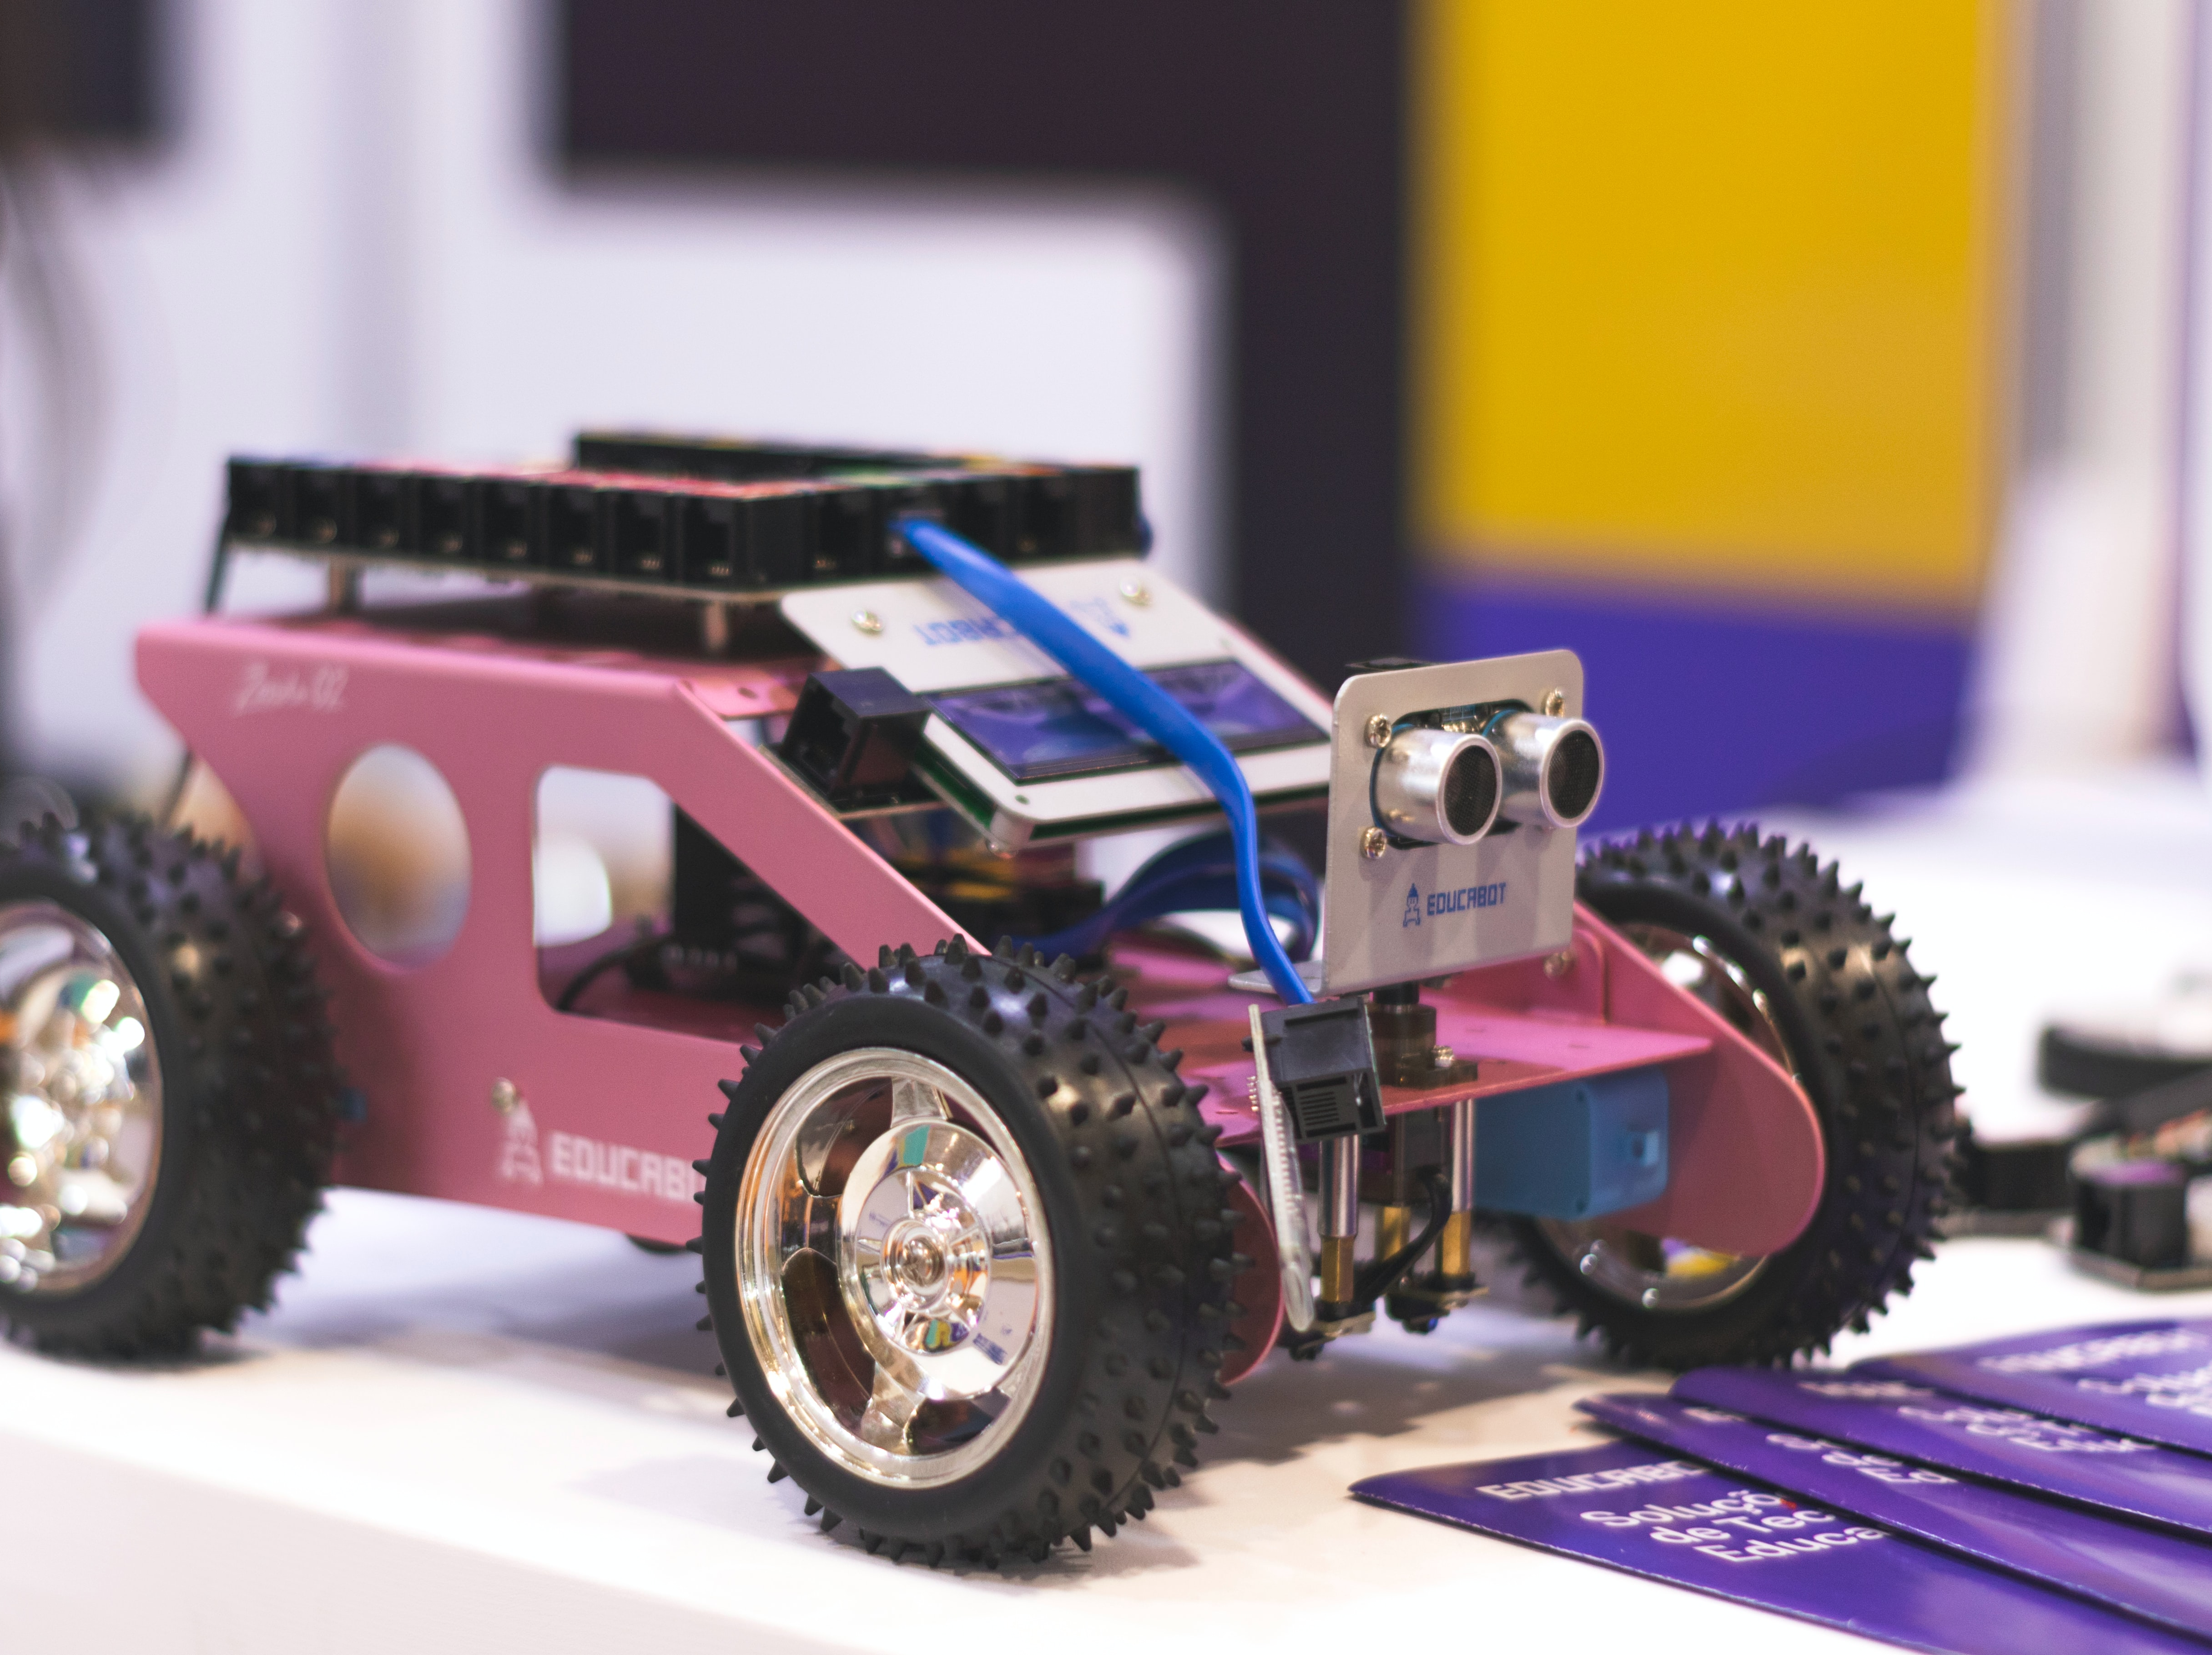
Let's start Tinkering

Slide 6

Robotics is the combination of engineering, science and technology that produces a machine called robot.
It is a machine that is programmed to perform the given tasks and gather information from its surroundings
a branch of engineering that involves the conception, design, manufacture and operation of robots. The objective of the robotics field is to create intelligent machines that can assist humans in a variety of ways.
robotics

Slide 7
Laws of robotics:
Law 1: A robot may not injure a human being or through inaction, allow a human being to come to harm
Law 2: A robot must obey orders given to it by human beings, except where such orders would conflict with the first law
Law 3: A robot must protect its own existence as long as such protection does not conflict with the first law.

Slide 8
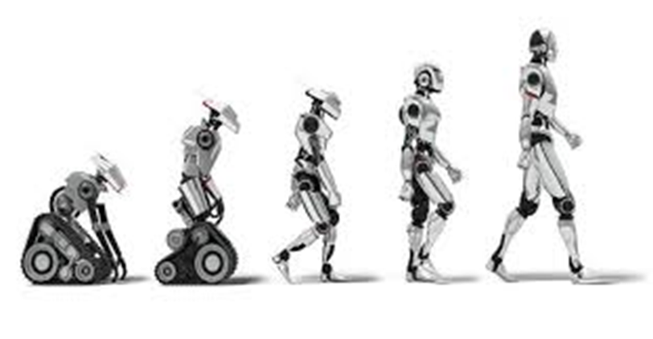
Types of robots ?
Industrial Robots
Educational Robots
Mobile Robots
Autonomous Robots
UAV

Slide 9
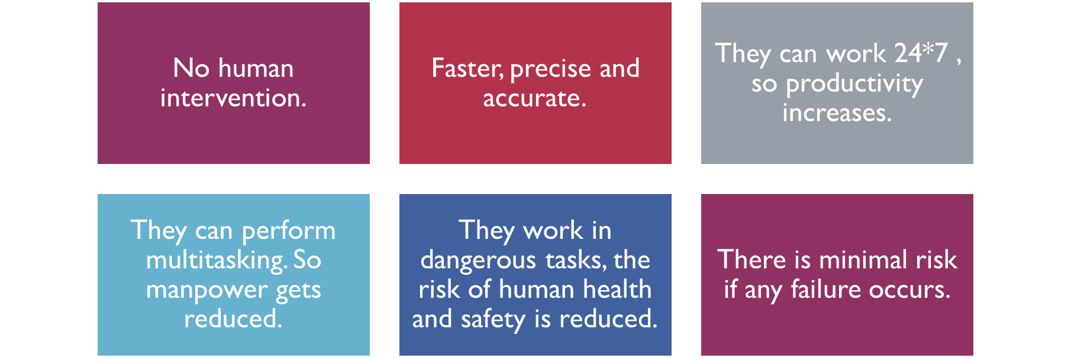
Advantages of Robotics

Slide 10
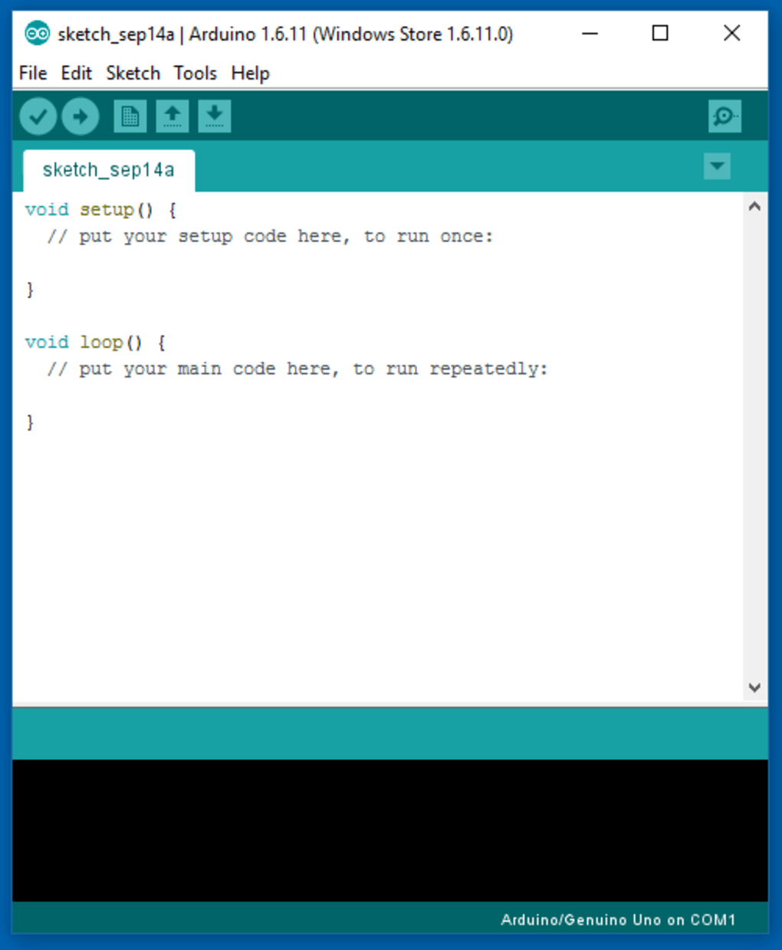
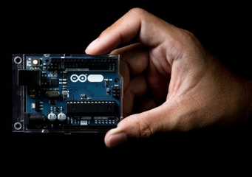
What is ARDUINO?
Arduino is a hardware platform as well as software that helps people to make digital devices such as robots.

Slide 11
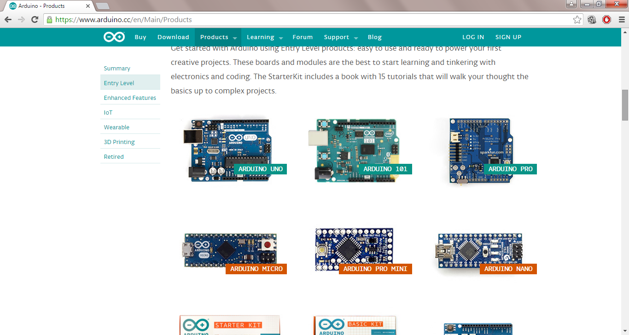
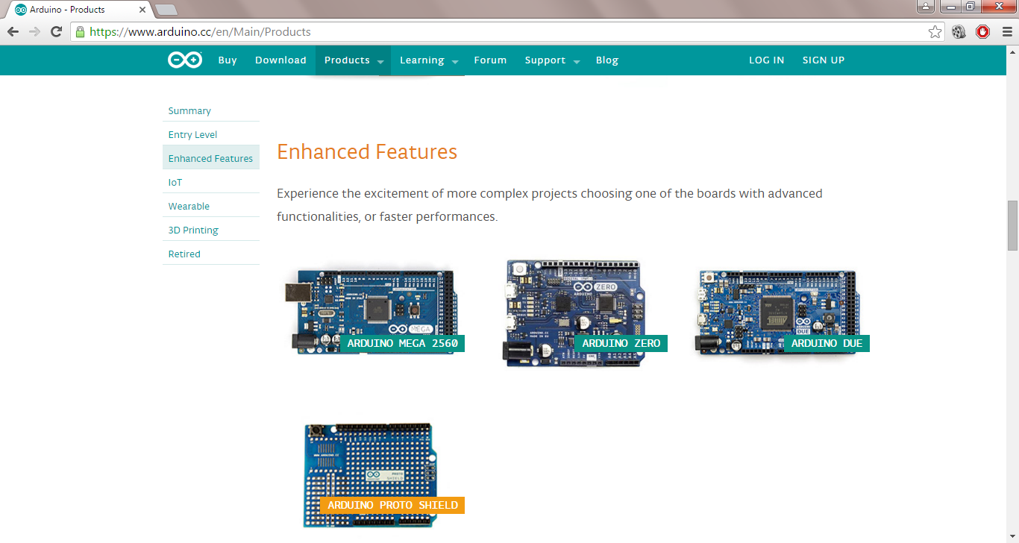
Different Varieties of Arduino

Slide 12
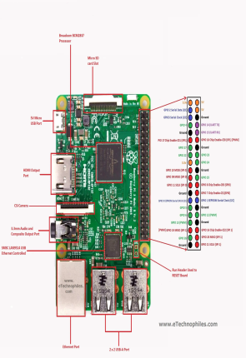
Raspberry Pi is a series of small single-board computers (SBCs) developed in the United Kingdom by the Raspberry Pi Foundation in association with Broadcom. The Raspberry Pi project originally leaned towards the promotion of teaching basic computer science in schools.
Rasberry pi

Slide 13
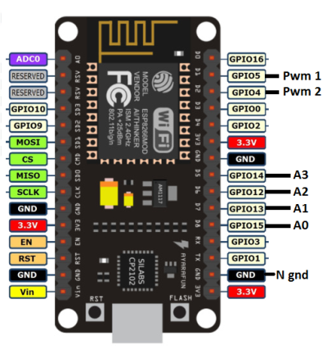
NodeMCU is based on the Esperessif ESP8266-12E WiFi System-On-Chip, loaded with an open-source, Lua-based firmware. it’s perfect for IoT applications, and other situations where wireless connectivity is required. This chip has a great deal in common with the Arduino – they’re both microcontroller-equipped prototyping boards which can be ...
.
Node MCU

Slide 14
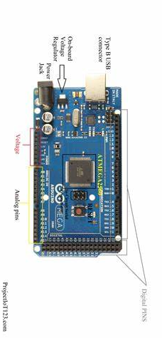
The 8-bit board with 54 digital pins, 16 analog inputs,
and 4 serial ports. The Arduino Mega 2560 is a microcontroller board based on the ATmega2560
Arduino Mega

Slide 15
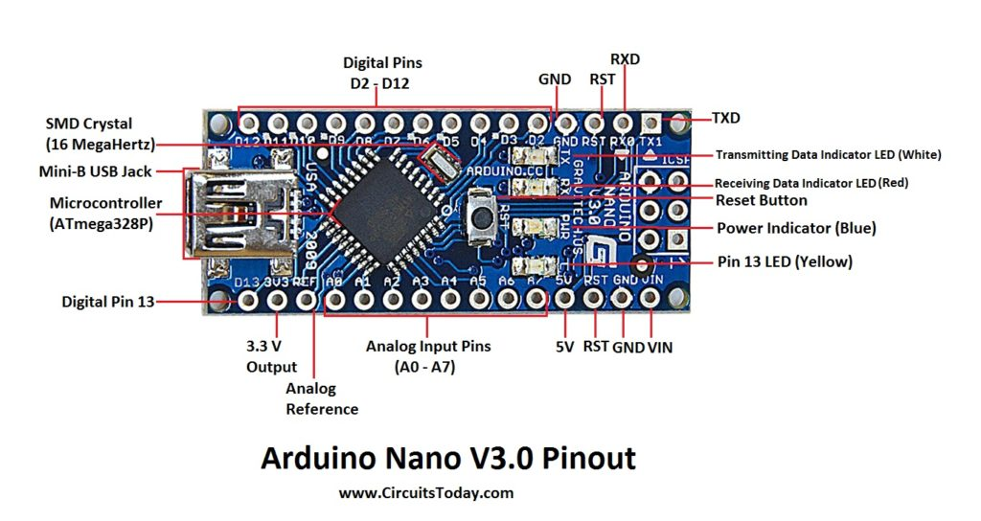
The Arduino Nano, as the name suggests is a compact, complete and bread-board friendly microcontroller board. The Nano board weighs around 7 grams with dimensions of 4.5 cms to 1.8 cms (L to B). This article discusses about the technical specs most importantly the pinout and functions of each and every pin in the Arduino Nano board.
Arduino Nano

Slide 16
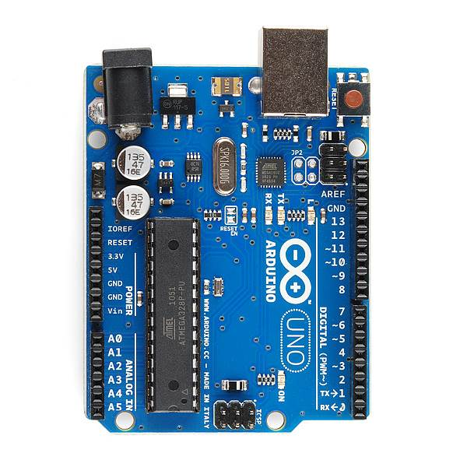
USB
(to Computer)
PWR IN
RESET
POWER
5V / 3.3V / GND
Digital I\O
PWM(3, 5, 6, 9, 10, 11)
Analog INPUTS
Arduino UNO
Notes:
Look up analog ref

Slide 17
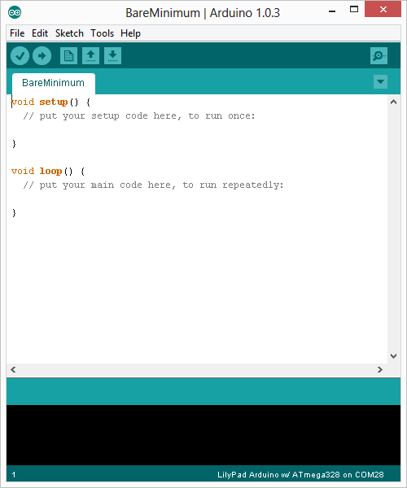
Arduino Integrated Development Environment (IDE)
Two required functions / methods / routines:
void setup()
{
// runs once
}
void loop()
{
// repeats
}
Notes:
Be sure to point out the what all of the buttons do.

Slide 18
SYNTAX
Rules to follow in order to how a complete program .
; semi column
{ Curly braces
() Open & close Parentheses

Slide 19

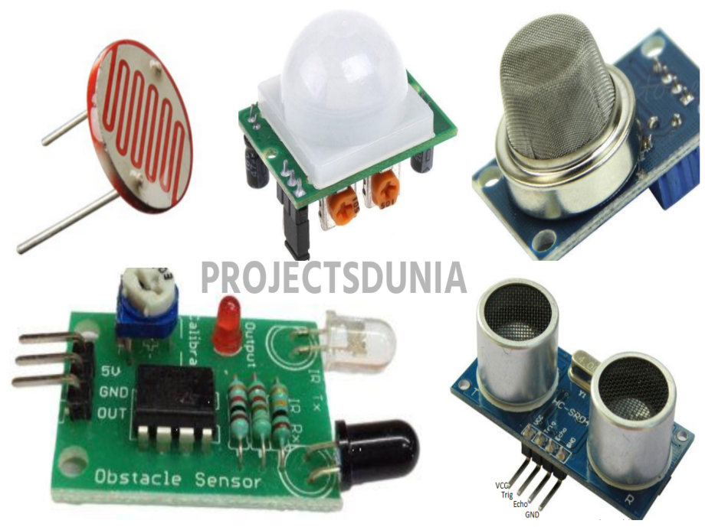
Arduino Uno and sensors

Slide 20
What is a sensor?
Sensors are devices that convert a physical quantity, such as light intensity or temperature, into an electrical quantity.
One reason that an Arduino is so useful is that it can easily collect information from sensors.
There are many different types of sensors: Light sensor, Motion sensor, Sound sensor, Temperature sensor, Magnetic fields sensor, Gravity sensor, Humidity sensor, Vibration sensor Pressure sensor, Position sensor etc.

Slide 21
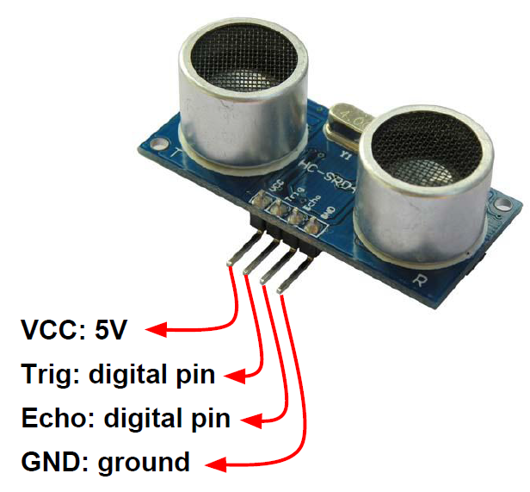
Ultrasonic sensor This sensor measures distance using sound waves which bounce back to the sensor

Slide 22
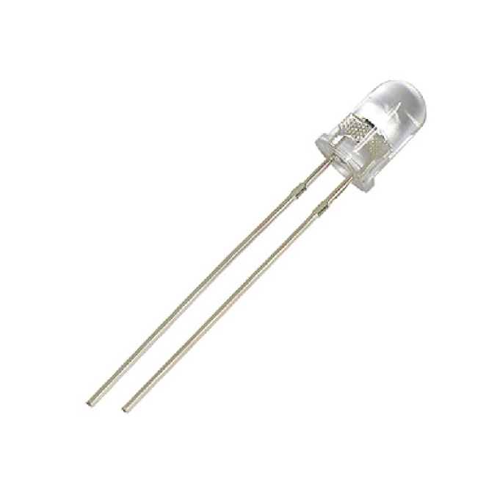
LED a light-emitting diode (a semiconductor diode which glows when a voltage is applied). "light sources can be fluorescent tubes, optical fibres, or LEDs"

Slide 23
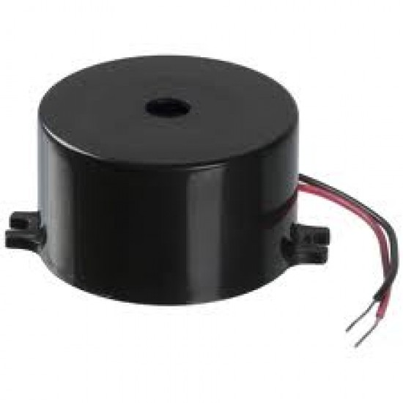
Buzzer A buzzer or beeper is an audio signaling device, which may be mechanical, electromechanical, or piezoelectric (piezo for short).

Slide 24
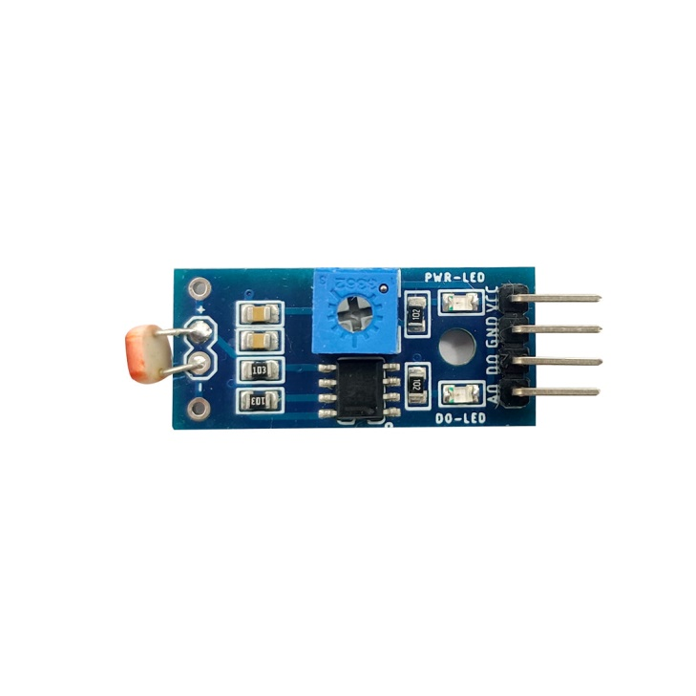
LDR LDR (Light Dependent Resistor) as the name states is a special type of resistor that works on the photoconductivity principle

Slide 25
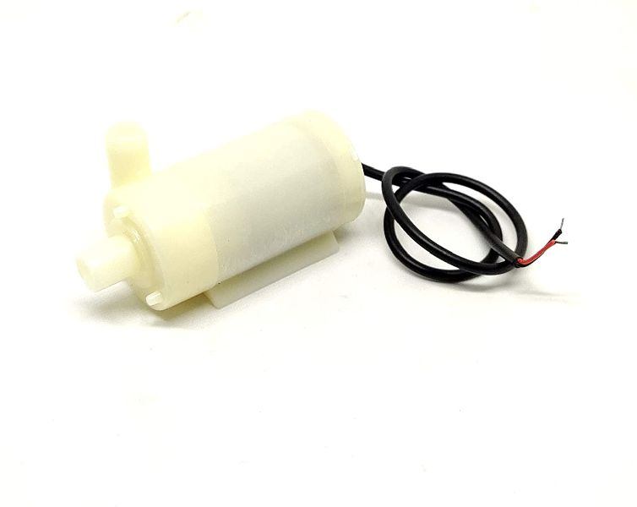
PUMP DC powered pumps use direct current from motor, battery, or solar power to move fluid in a variety of ways.

Slide 26
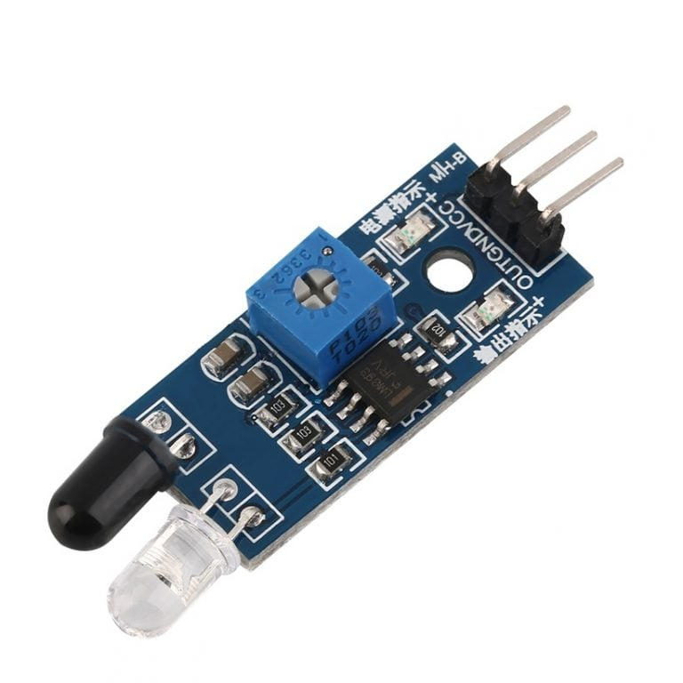
Infrared sensor IR sensor is an electronic device, that emits the light in order to sense some object of the surroundings. An IR sensor can measure the heat of an object as well as detects the motion. Usually, in the infrared spectrum, all the objects radiate some form of thermal radiation. These types of radiations are invisible to our eyes, but infrared sensor can detect these radiations.

Slide 27
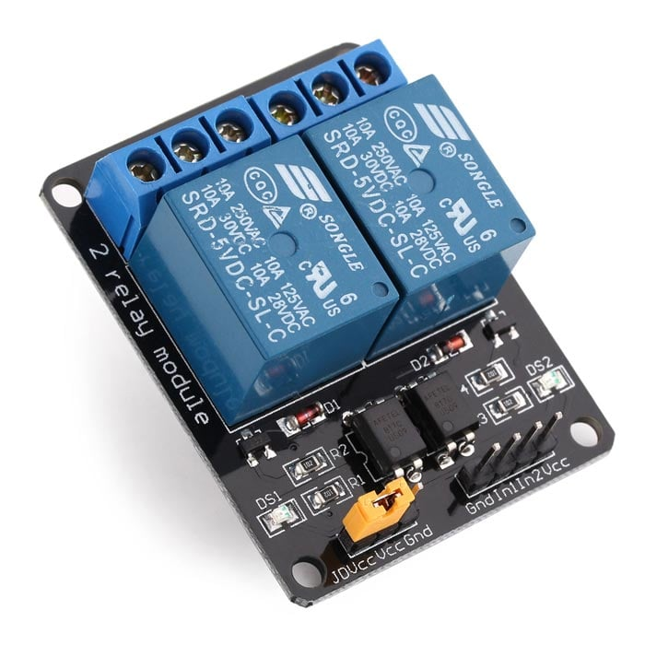
Relay Module It can be used to control various appliances and other types of equipment with a large current. It can be controlled directly with 3.3V or 5V logic signals from a microcontroller GND – Connect 0V to this pin. IN1 – Controls relay 1, active Low Relay will turn on when this input goes below about 2.0V IN2 – Controls relay 2, active Low Relay will turn on when this input goes below about 2.0V VCC – Connect 5V to this pin. Is used to power the optocouplers

Slide 28
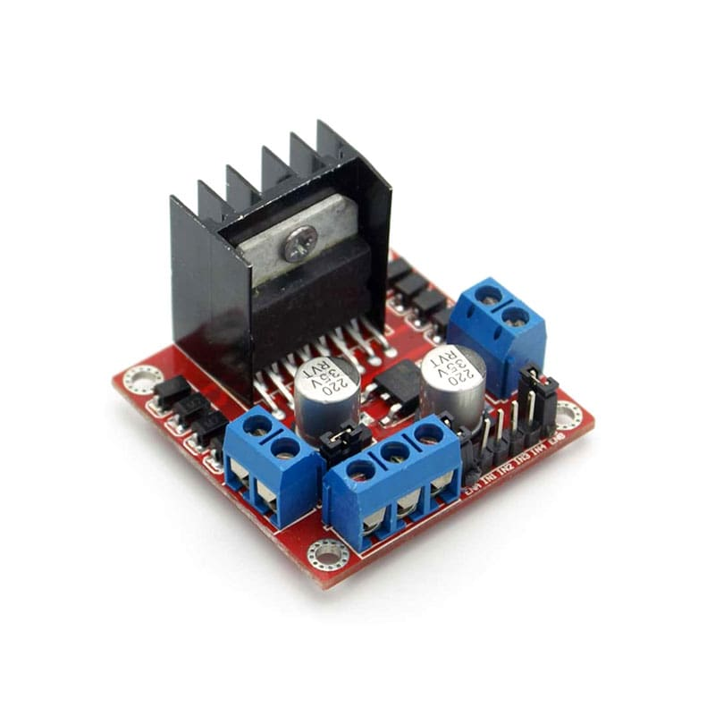
Motor Driver Motor Driver Module is a high power motor driver perfect for driving DC Motors and Stepper Motors. It uses the popular L298 motor driver IC and has the onboard 5V regulator which it can supply to an external circuit. It can control up to 4 DC motors, or 2 DC motors with directional and speed control

Slide 29
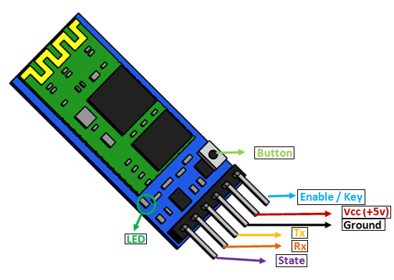
HC 05 (BLUETOOTH MODULE) The HC-05 module is a Bluetooth SPP (Serial Port Protocol) module, which means it communicates with the Arduino via the Serial Communication

Slide 30
Soil Mosture Sensor The HC-05 module is a Bluetooth SPP (Serial Port Protocol) module, which means it communicates with the Arduino via the Serial Communication

Slide 31
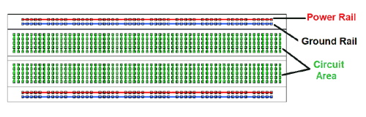
BREADBOARD breadboard is a solderless device for temporary prototype with electronics and test circuit designs.

Slide 32
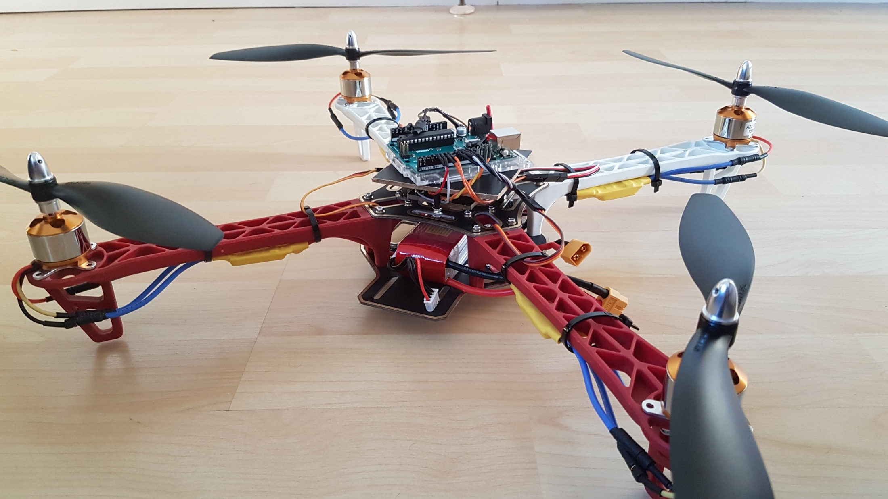
Arduino based drone

Slide 33
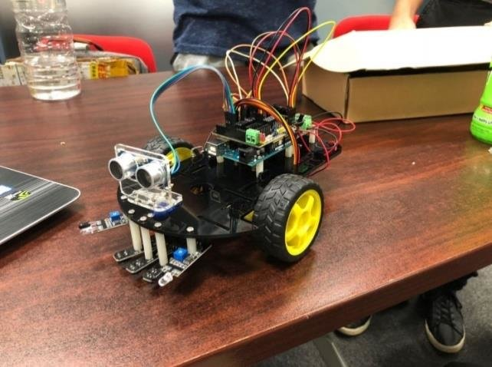
Arduino based robot

Slide 34


